Slide 1
Banking Data Analysis – SQL: A Visual Overview
Data Visualization: Charts and graphs highlight key findings from our SQL banking data analysis, focusing on inactive customer identification and fraud detection.
SQL Queries: SQL extracts insights on monthly transactions, customer deposits, and daily volume, identifying high-value customers and potential fraud.
Key Insights: Actionable business strategies from our analysis include identifying high-deposit customers, top-performing branches, and transaction trends across age groups.

Slide 2

INTRODUCTION
Welcome to my presentation on bank analysis using SQL. This project aims to provide comprehensive insights into banking data through the effective use of SQL for data extraction, transformation, and analysis. By leveraging SQL's robust querying capabilities, we delve into various aspects of banking operations, from transaction patterns and customer behaviors to financial performance metrics.

Slide 3
Q.1 . Write a query to list all the customers who haven’t made any transaction in the last year how can we make them active again
Query :
Action :
Reach out to inactive customers with personalized offers and incentives. This could include targeted marketing campaigns, fee waivers, or exclusive product promotions.
SELECT c.customer_id, c.first_name, c.last_name
FROM customers c
JOIN accounts a ON c.customer_id = a.customer_id
LEFT JOIN transactions t ON a.account_number = t.account_number
WHERE t.transaction_id IS NULL OR
t.transaction_date < DATE_SUB(CURDATE(), INTERVAL 1 YEAR);

Slide 4
Q.2 Summarize total transaction account per account per month
Query :
Analysis :
Analyze trends in monthly transaction volume, identifying peak periods and potential seasonal patterns. This data helps optimize resource allocation and marketing strategies.
SELECT account_number, YEAR(transaction_date) AS year,
MONTH(transaction_date) AS month, SUM(amount) AS total_amt
FROM transactions t
GROUP BY account_number, YEAR(transaction_date), MONTH(transaction_date)
ORDER BY account_number, year, month;

Slide 5
Q.3. Rank branches based on the total amount of deposits made in the last quarter.
Query :
Analysis :
SELECT a.branch_id,sum(t.amount) , dense_rank() over(order by sum(t.amount) desc) as branch_rank from accounts a inner join transactions t using(account_number) where t.transaction_type="Deposit" and t.transaction_date>=date_sub(current_date(),interval 3 month) group by a.branch_id order by branch_rank;
The ranking highlights branch performance in terms of deposit activity over the last quarter, offering insights into customer trust and regional financial behavior.

Slide 6
Q.4 . Find the name of the customer who has deposited the highest amount
Query :
Significance :
SELECT concat(c.first_name," ",c.last_name) as full_name, t.amount from customers c inner join accounts a on c.customer_id=a.customer_id inner join transactions t on t.account_number=a.account_number where t.transaction_type="Deposit" order by t.amount desc limit 1;
Understanding the customer with the highest deposit allows for targeted rewards programs or personalized service offerings.
.

Slide 7

Q.5 . Accounts that have made more than two transactions in a single day, which could indicate fraudulent activity
Query :
Action :
Accounts flagged for potential fraud require further investigation. Analyze transaction patterns and contact customers for clarification. Consider implementing fraud detection systems.
SELECT a.account_number AS fraud_accounts, COUNT(t.transaction_id) AS no_of_transactions, DAY(t.transaction_date) AS single_day
FROM accounts a INNER JOIN transactions t
USING(account_number)
GROUP BY fraud_accounts, single_day
HAVING no_of_transactions > 2;

Slide 8
Q.6 . Average Transactions Per Customer
Query
Interpretation :
SELECT a.customer_id, a.account_number, YEAR(t.transaction_date) AS transaction_year, MONTH(t.transaction_date) AS transaction_month, COUNT(t.transaction_id) AS num_transactions FROM accounts a
INNER JOIN transactions t ON a.account_number = t.account_number
WHERE t.transaction_date >= DATE_SUB(CURRENT_DATE(), INTERVAL 1 YEAR) GROUP BY a.customer_id, a.account_number, YEAR(t.transaction_date), MONTH(t.transaction_date) ) SELECT customer_id, account_number, ROUND(AVG(num_transactions), 2) AS avg_month_trans FROM MonthlyTransactions GROUP BY customer_id, account_number ORDER BY avg_month_trans DESC
Compare customer activity levels to identify trends and potential areas for improvement. This data can inform marketing campaigns and customer engagement initiatives.

Slide 9
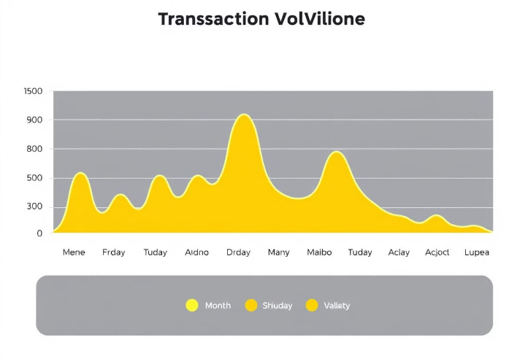
Q.7. Daily Transaction Volume
Query :
Application :
Analyze daily transaction volume to identify potential patterns and anticipate peaks in demand. This data can help optimize staffing levels and cash flow management.
SELECT date(transaction_date) as transaction_day,round(sum(amount),3) as Transactions_volume from transactions where transaction_date>=date_sub(current_date(),interval 1 month) group by transaction_day order by transaction_day;

Slide 10
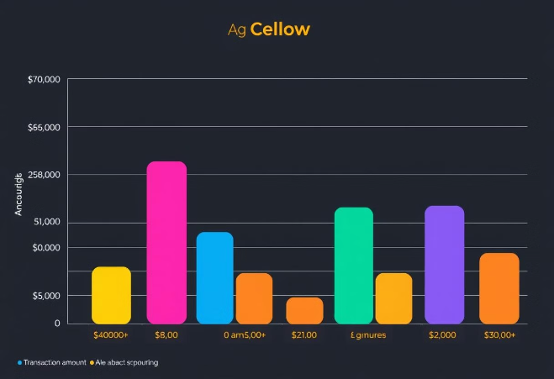
Q.8 . Transaction Amount by Age Group
Query :
Insights :
SELECT case When floor((datediff(current_date(),c.date_of_birth)/365)) between 0 and 17 then "0-17" When floor((datediff(current_date(),c.date_of_birth)/365)) between 18 and 30 then "18-30" When floor((datediff(current_date(),c.date_of_birth)/365)) between 31 and 60 then "31-60" else "60+" end as age_group, sum(t.amount) as total_trans_amt from customers c inner join accounts a on c.customer_id=a.customer_id inner join transactions t on t.account_number=a.account_number where t.transaction_date>=date_sub(current_date(),interval 1 year) group by age_group;
Analyze transaction volume across different age groups to tailor products and services to specific customer segments. This data can inform marketing campaigns and product development.

Slide 11
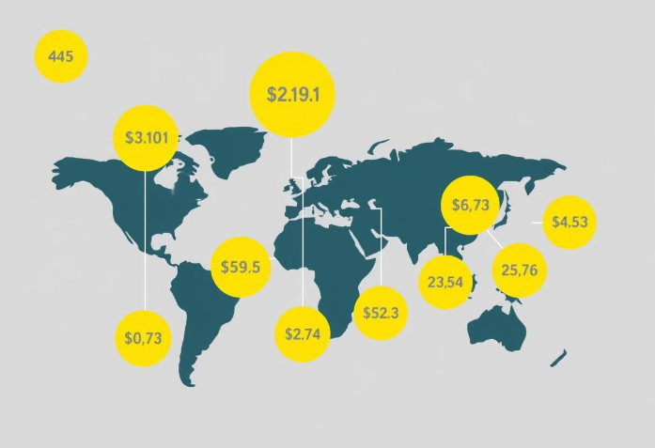
Q.9 . Branch with Highest Average Balance
Query :
Application :
Identify high-performing branches based on average account balance. This data can help streamline operations, allocate resources efficiently, and recognize outstanding branches for performance.
SELECT branch_id,avg(balance) as avg_balance from accounts group by branch_id order by avg_balance desc limit 1;

Slide 12
Q.10 Calculate the average balance per customer at the end of each month in last year
Query :
Analysis :
SELECT a.customer_id,year(t.transaction_date) as year,month(t.transaction_date) as month ,round(avg(a.balance),2)as balance from accounts a join transactions t using(account_number) where t.transaction_date>=date_sub(current_date,interval 1 year) group by customer_id,year,month order by year,month;
The query highlights monthly average balances for each customer, allowing analysis of saving or spending habits. This helps identify high-value customers and periods of increased or decreased activity.

Slide 13
Key Takeaways and Next Steps
Key Findings
Improved Engagement
Better Resource Use
Our SQL analysis provided key insights into inactive customers, monthly transaction patterns, and top-performing branches.
By targeting efforts based on these findings, we expect improved customer engagement and subsequent growth.
These data-driven decisions will allow us to optimize resource allocation and increase profitability.

